Slide 1
Introduction
Chapter 1

Slide 2
Definition of a Distributed System (1)
A distributed system is:
A collection of independent computers that appears to its users as a single coherent system.

Slide 3
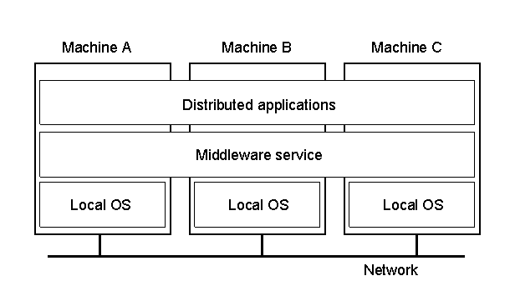
Definition of a Distributed System (2)
1.1
A distributed system organized as middleware.
Note that the middleware layer extends over multiple machines.

Slide 4
Transparency in a Distributed System
Transparency | Description
Access | Hide differences in data representation and how a resource is accessed
Location | Hide where a resource is located
Migration | Hide that a resource may move to another location
Relocation | Hide that a resource may be moved to another location while in use
Replication | Hide that a resource may be shared by several competitive users
Concurrency | Hide that a resource may be shared by several competitive users
Failure | Hide the failure and recovery of a resource
Persistence | Hide whether a (software) resource is in memory or on disk
Different forms of transparency in a distributed system.

Slide 5
Scalability Problems
Concept | Example
Centralized services | A single server for all users
Centralized data | A single on-line telephone book
Centralized algorithms | Doing routing based on complete information
Examples of scalability limitations.

Slide 6
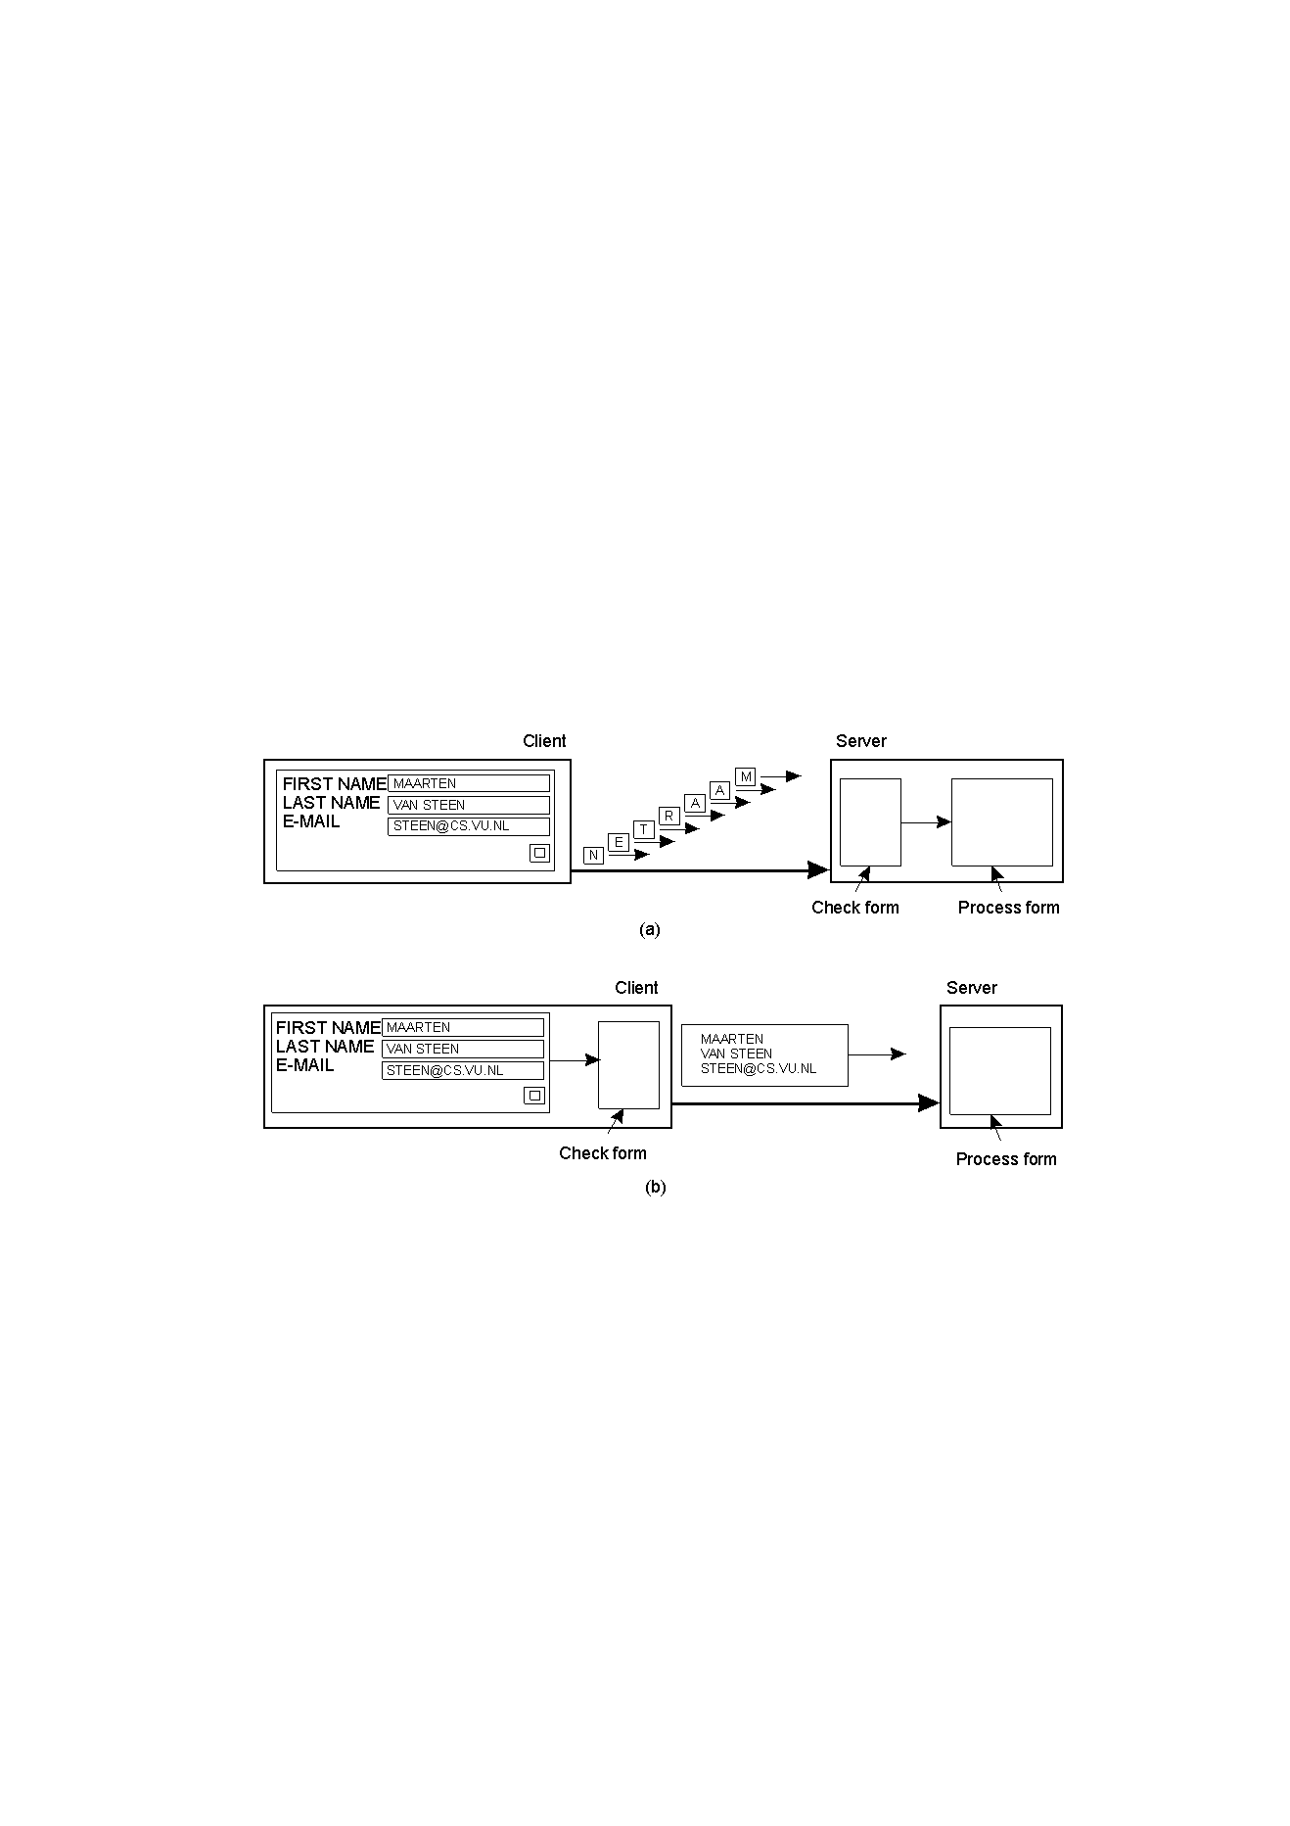
Scaling Techniques (1)
1.4
The difference between letting:
a server or
a client check forms as they are being filled

Slide 7
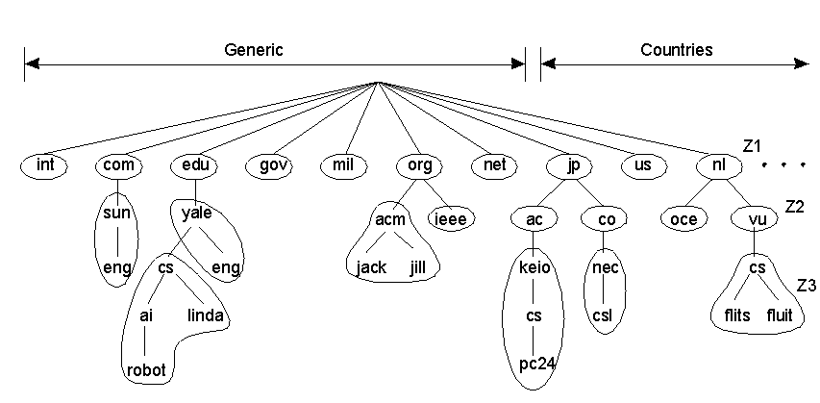
Scaling Techniques (2)
1.5
An example of dividing the DNS name space into zones.

Slide 8
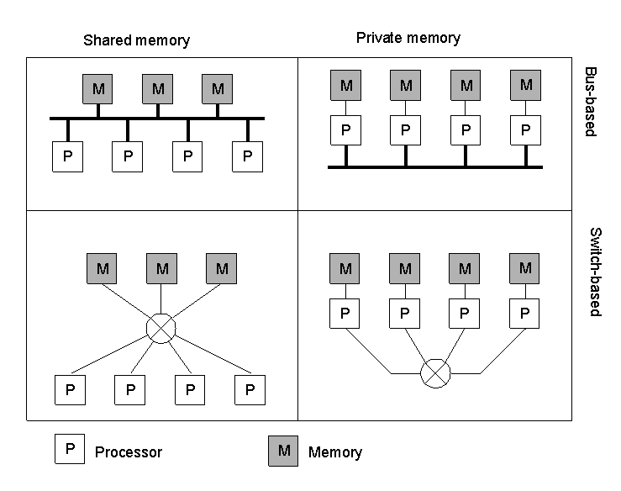
Hardware Concepts
1.6
Different basic organizations and memories in distributed computer
systems

Slide 9
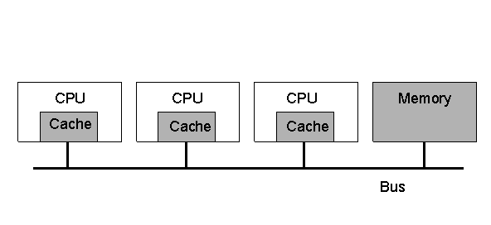
Multiprocessors (1)
1.7
A bus-based multiprocessor.

Slide 10
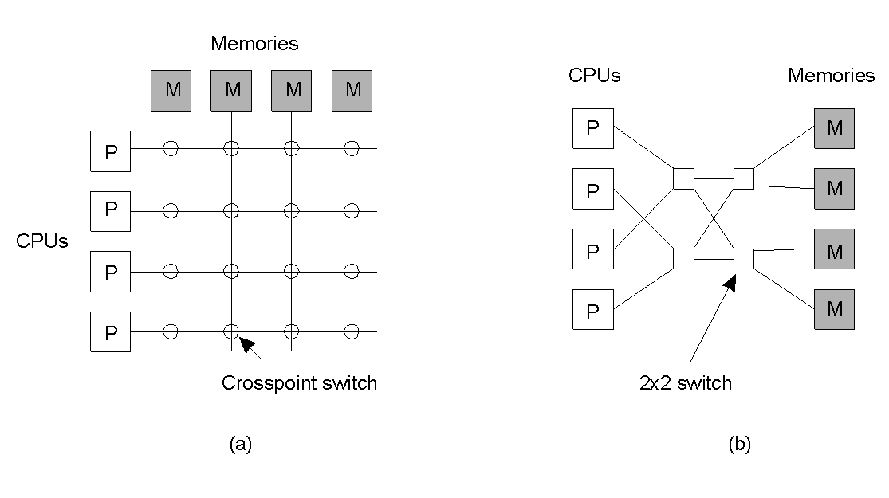
Multiprocessors (2)
1.8
A crossbar switch
An omega switching network

Slide 11
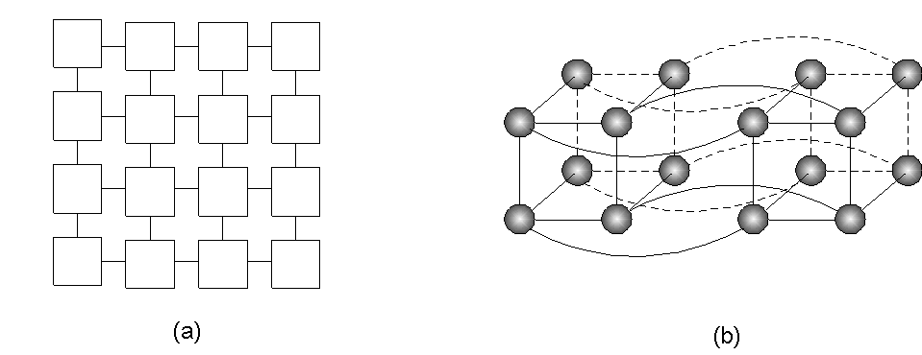
Homogeneous Multicomputer Systems
1-9
Grid
Hypercube

Slide 12
Software Concepts
System | Description | Main Goal
DOS | Tightly-coupled operating system for multi-processors and homogeneous multicomputers | Hide and manage hardware resources
NOS | Loosely-coupled operating system for heterogeneous multicomputers (LAN and WAN) | Offer local services to remote clients
Middleware | Additional layer atop of NOS implementing general-purpose services | Provide distribution transparency
An overview of
DOS (Distributed Operating Systems)
NOS (Network Operating Systems)
Middleware

Slide 13
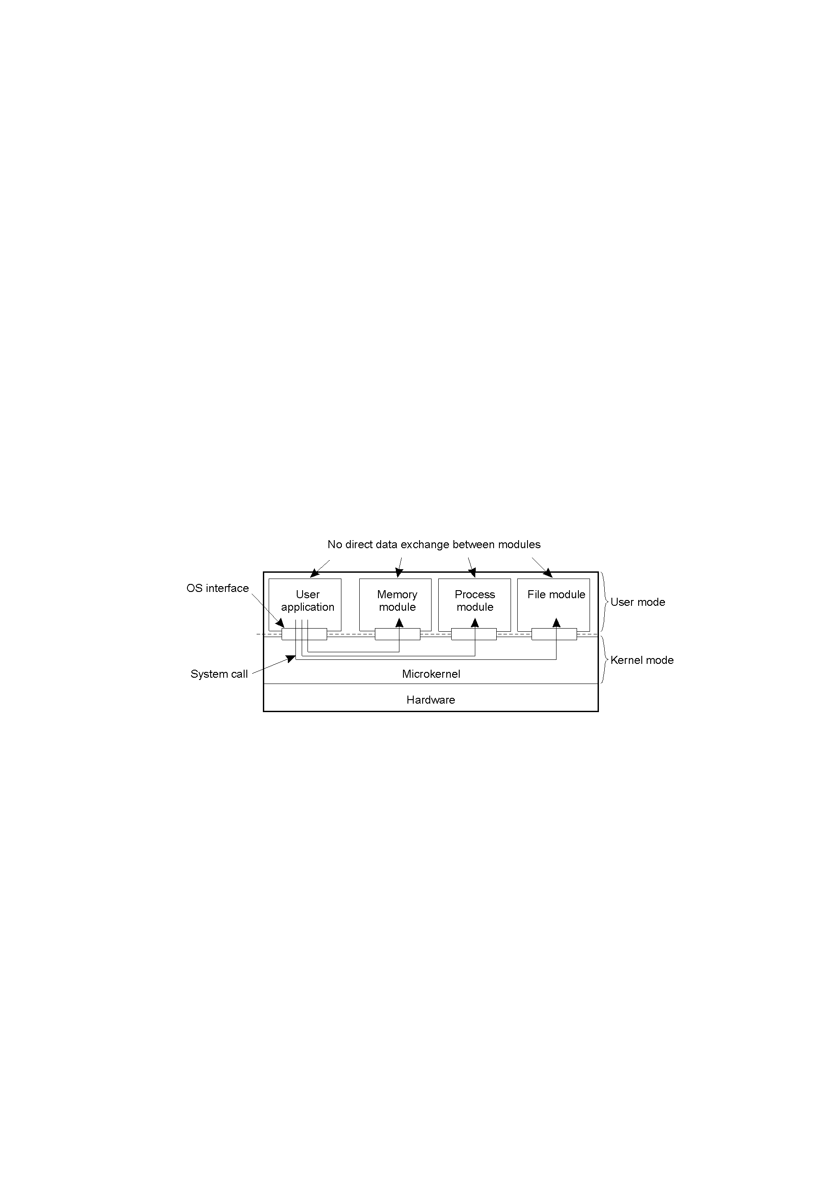
Uniprocessor Operating Systems
1.11
Separating applications from operating system code through
a microkernel.

Slide 14
Multiprocessor Operating Systems (1)
monitor Counter {
private:
int count = 0;
public:
int value() { return count;}
void incr () { count = count + 1;}
void decr() { count = count – 1;}
}
A monitor to protect an integer against concurrent access.

Slide 15
Multiprocessor Operating Systems (2)
monitor Counter {
private:
int count = 0;
int blocked_procs = 0;
condition unblocked;
public:
int value () { return count;}
void incr () {
if (blocked_procs == 0)
count = count + 1;
else
signal (unblocked);
}
void decr() {
if (count ==0) {
blocked_procs = blocked_procs + 1;
wait (unblocked);
blocked_procs = blocked_procs – 1;
}
else
count = count – 1;
}
}
A monitor to protect an integer against concurrent access, but
blocking a process.

Slide 16
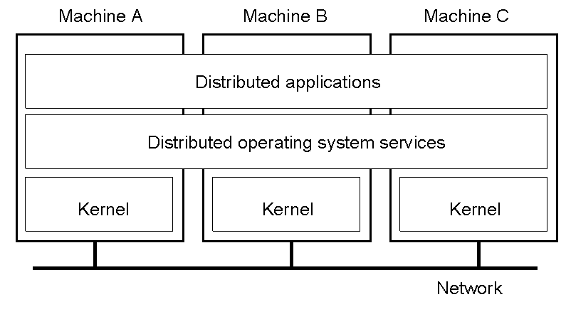
Multicomputer Operating Systems (1)
1.14
General structure of a multicomputer operating system

Slide 17
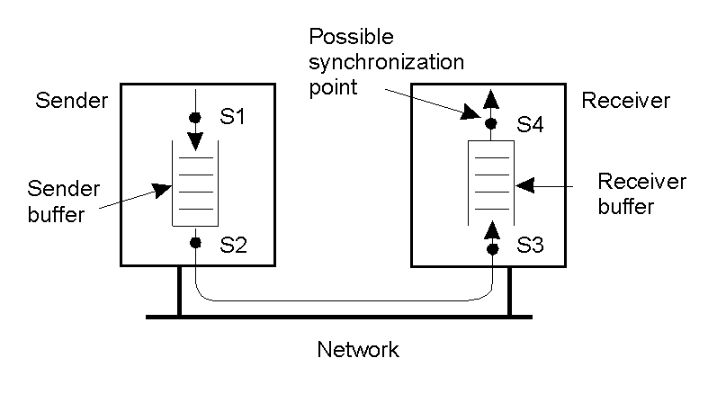
Multicomputer Operating Systems (2)
1.15
Alternatives for blocking and buffering in message passing.

Slide 18
Multicomputer Operating Systems (3)
Synchronization point | Send buffer | Reliable comm. guaranteed?
Block sender until buffer not full | Yes | Not necessary
Block sender until message sent | No | Not necessary
Block sender until message received | No | Necessary
Block sender until message delivered | No | Necessary
Relation between blocking, buffering, and reliable communications.

Slide 19
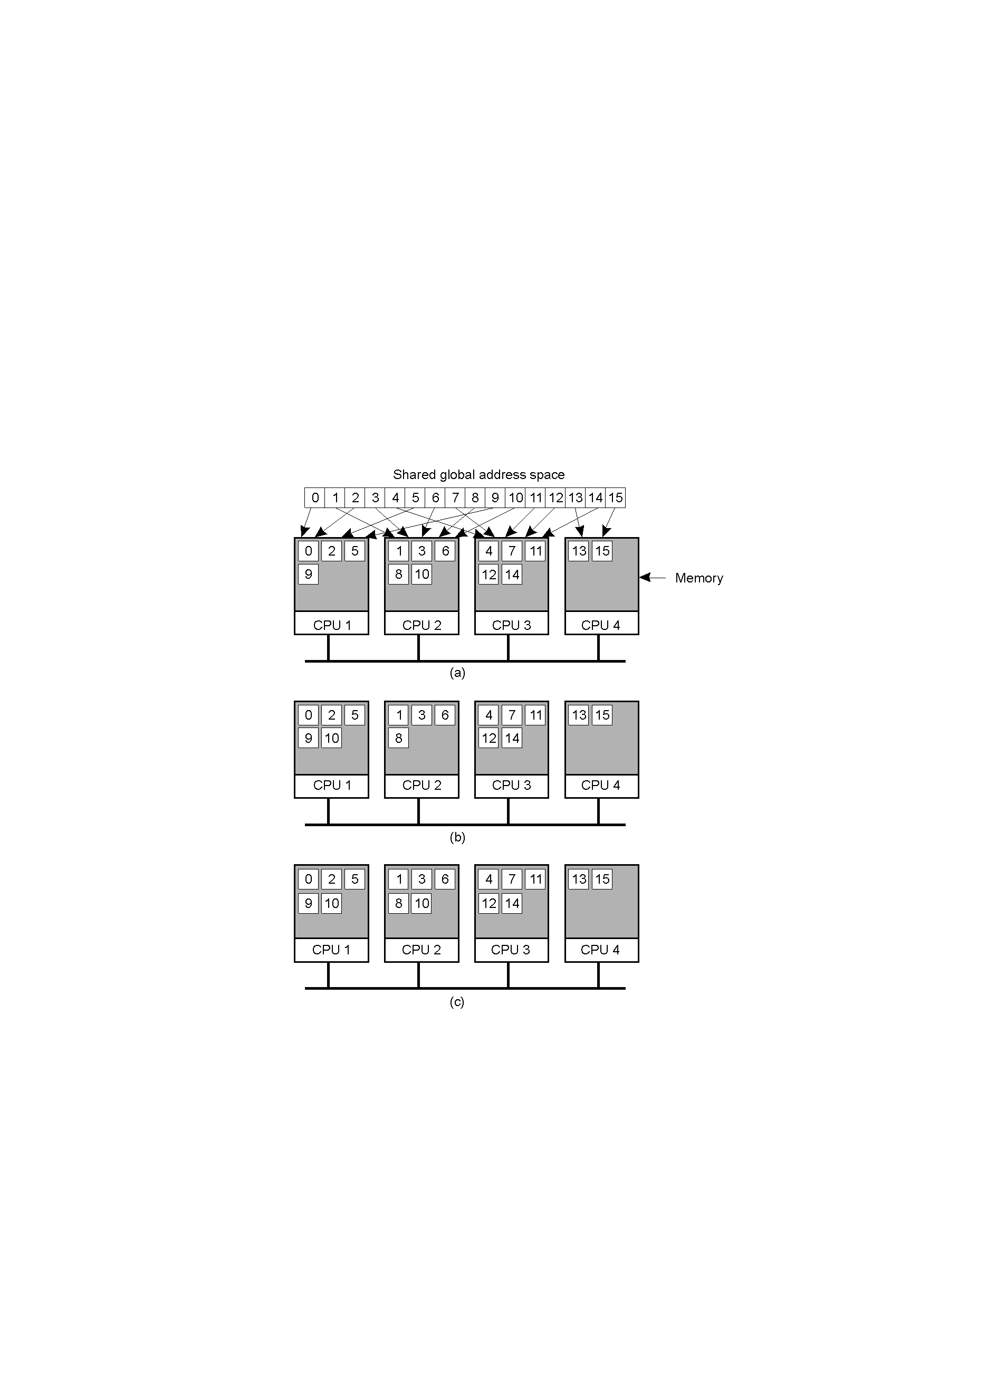
Distributed Shared Memory Systems (1)
Pages of address space distributed among four machines
Situation after CPU 1 references page 10
Situation if page 10 is read only and replication is used

Slide 20
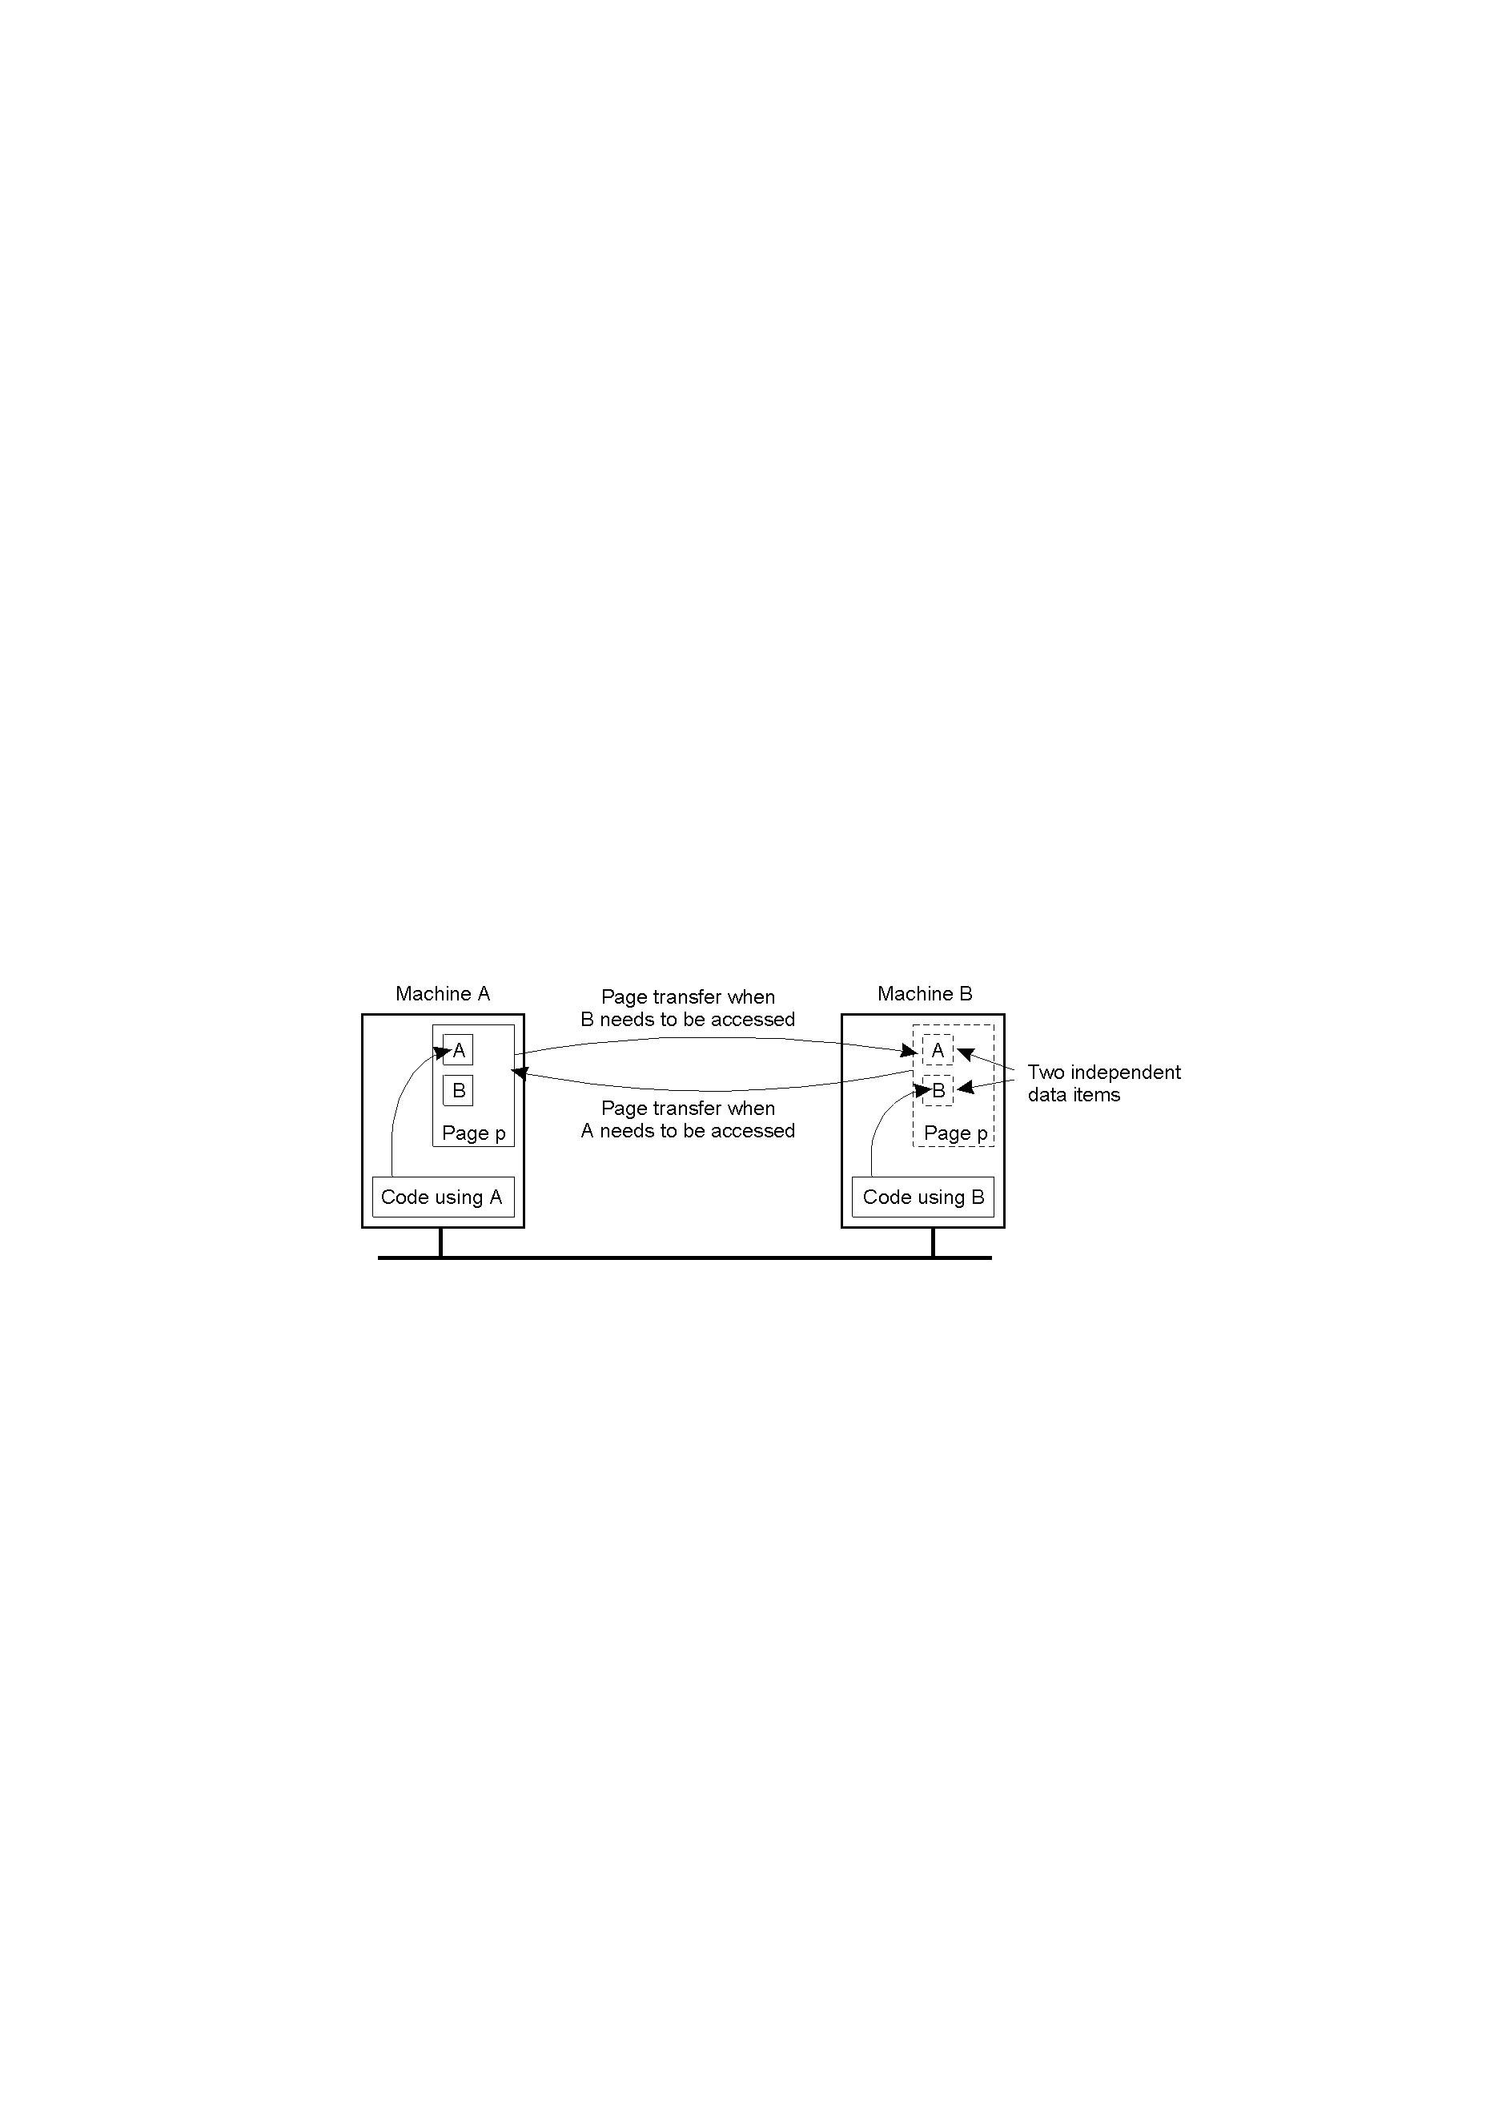
Distributed Shared Memory Systems (2)
1.18
False sharing of a page between two independent processes.

Slide 21
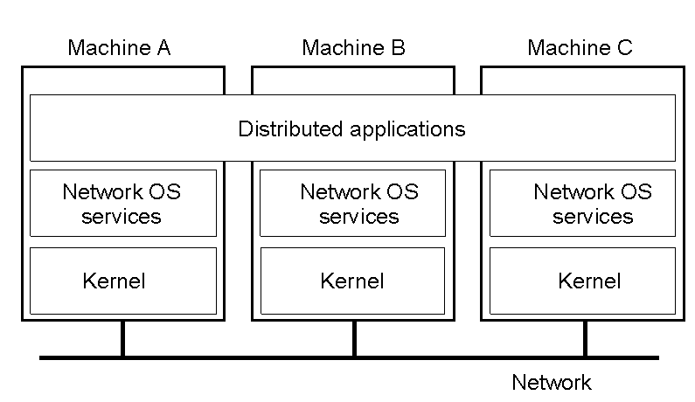
Network Operating System (1)
1-19
General structure of a network operating system.

Slide 22
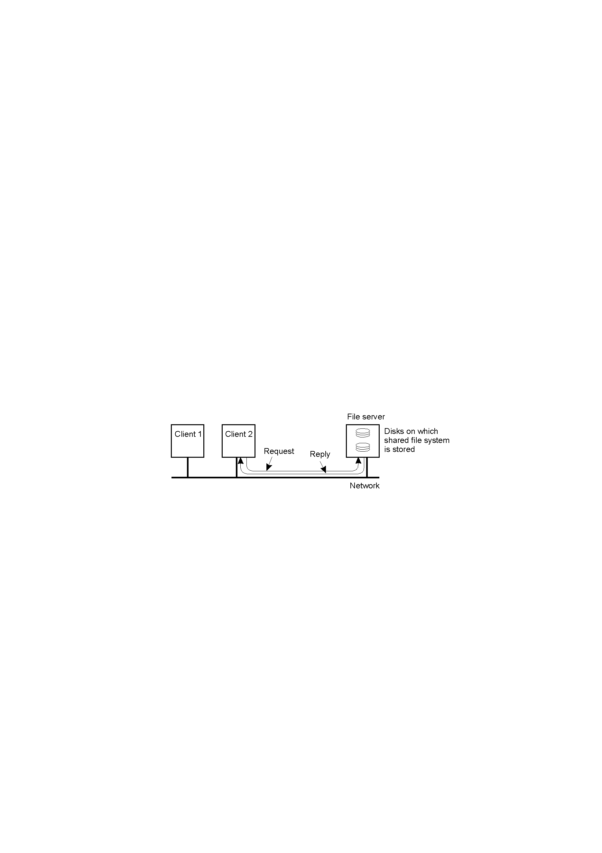
Network Operating System (2)
1-20
Two clients and a server in a network operating system.

Slide 23
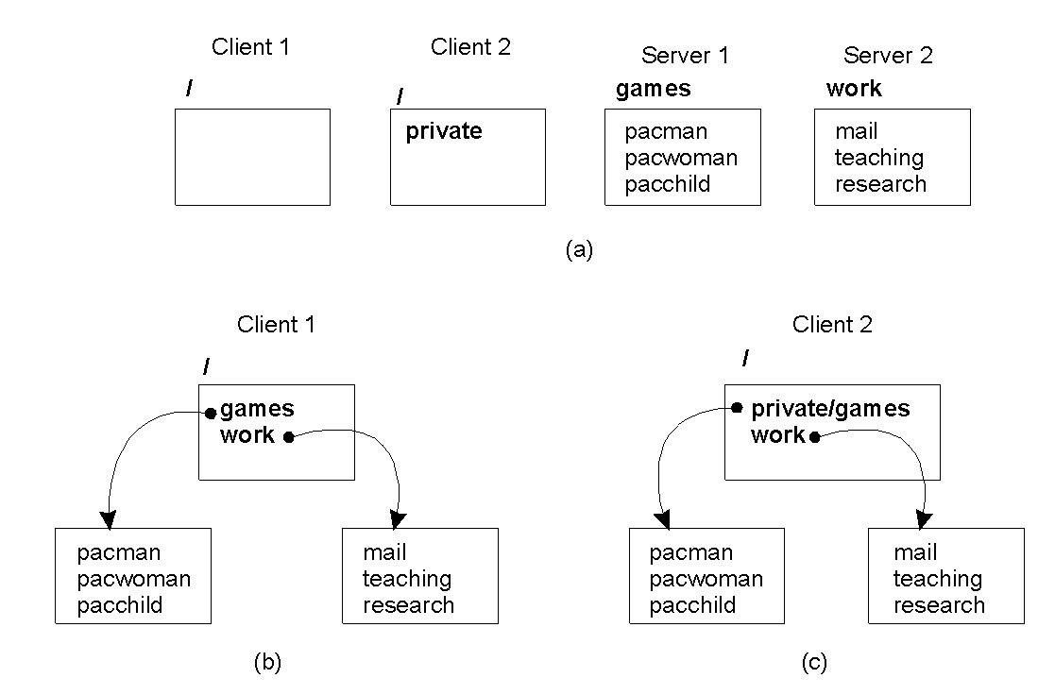
Network Operating System (3)
1.21
Different clients may mount the servers in different places.

Slide 24

Positioning Middleware
1-22
General structure of a distributed system as middleware.

Slide 25

Middleware and Openness
1.23
In an open middleware-based distributed system, the protocols used by each middleware layer should be the same, as well as the interfaces they offer to applications.

Slide 26
Comparison between Systems
Item | Distributed OS |  | Network OS | Middleware-based OS
 | Multiproc. | Multicomp.
Degree of transparency | Very High | High | Low | High
Same OS on all nodes | Yes | Yes | No | No
Number of copies of OS | 1 | N | N | N
Basis for communication | Shared memory | Messages | Files | Model specific
Resource management | Global, central | Global, distributed | Per node | Per node
Scalability | No | Moderately | Yes | Varies
Openness | Closed | Closed | Open | Open
A comparison between multiprocessor operating systems, multicomputer operating systems, network operating systems, and middleware based distributed systems.

Slide 27
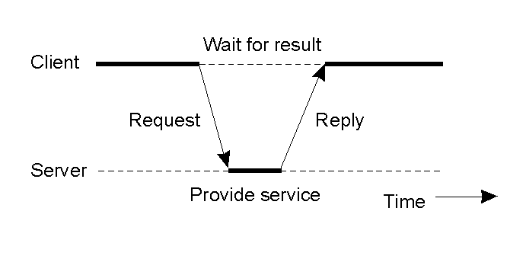
Clients and Servers
1.25
General interaction between a client and a server.

Slide 28
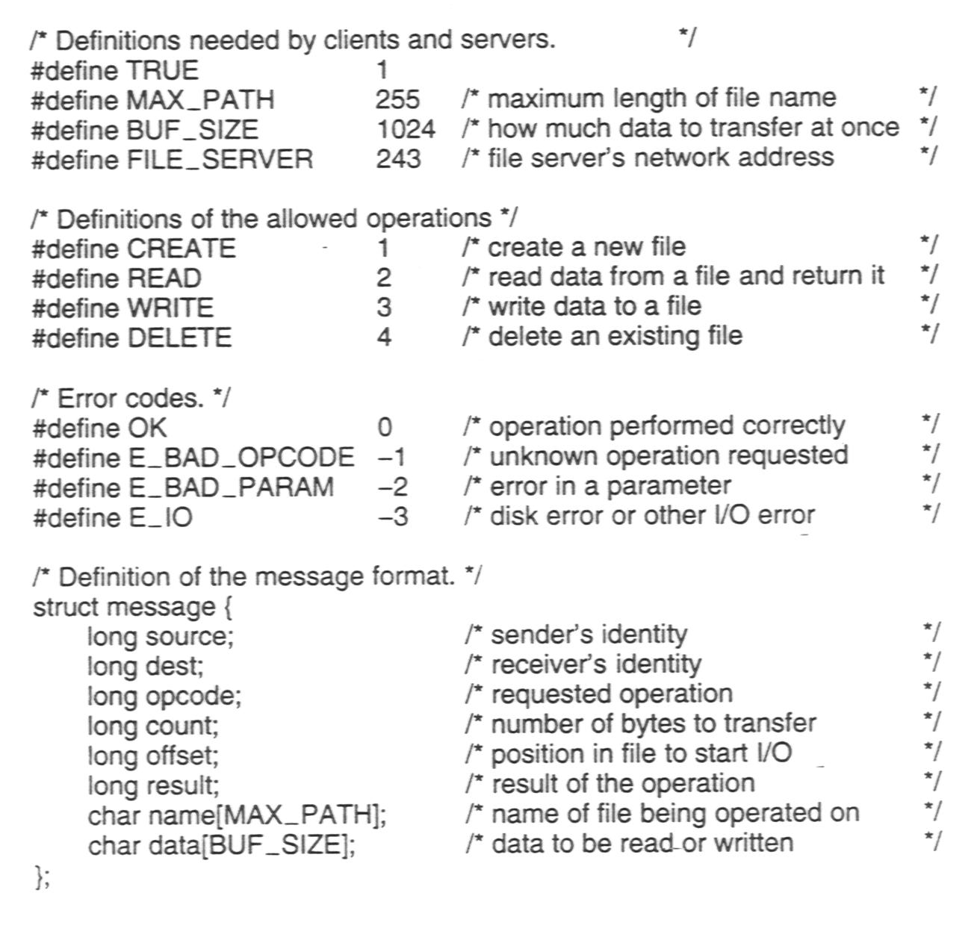
An Example Client and Server (1)
The header.h file used by the client and server.

Slide 29
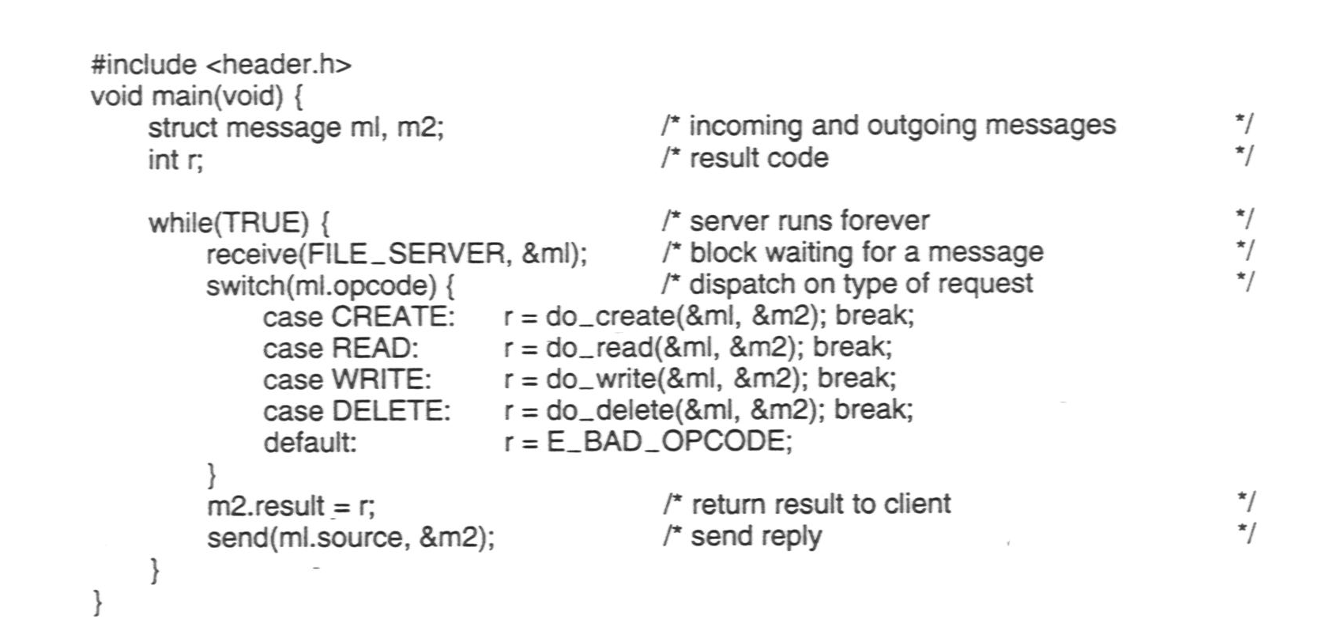
An Example Client and Server (2)
A sample server.

Slide 30
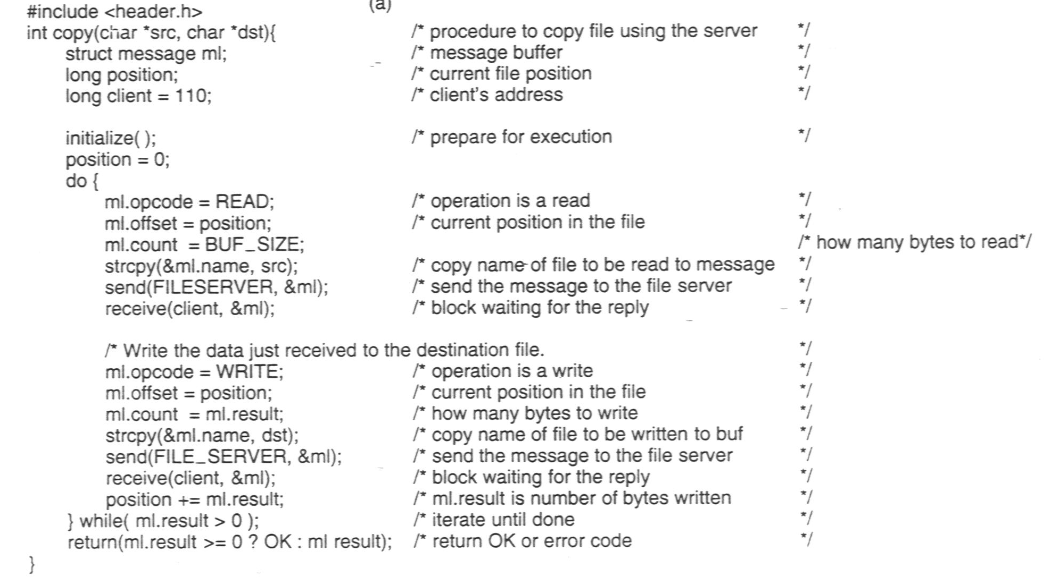
An Example Client and Server (3)
1-27 b
A client using the server to copy a file.

Slide 31
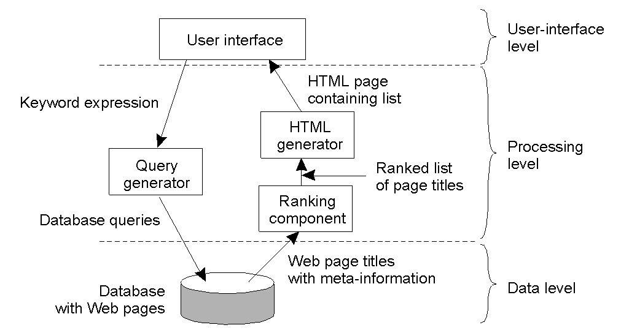
Processing Level
1-28
The general organization of an Internet search engine into three different layers

Slide 32
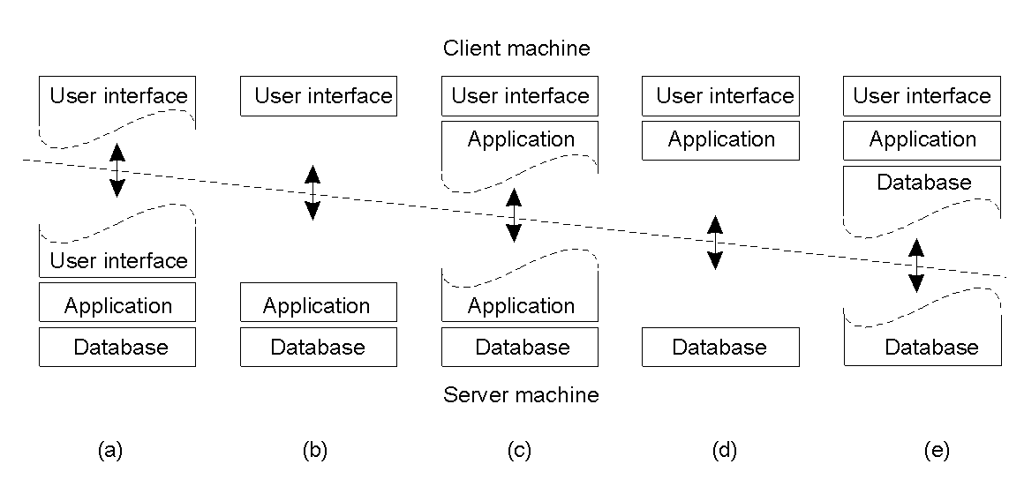
Multitiered Architectures (1)
1-29
Alternative client-server organizations (a) – (e).

Slide 33
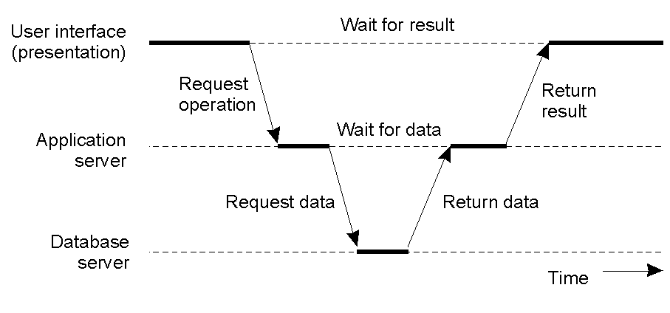
Multitiered Architectures (2)
1-30
An example of a server acting as a client.

Slide 34
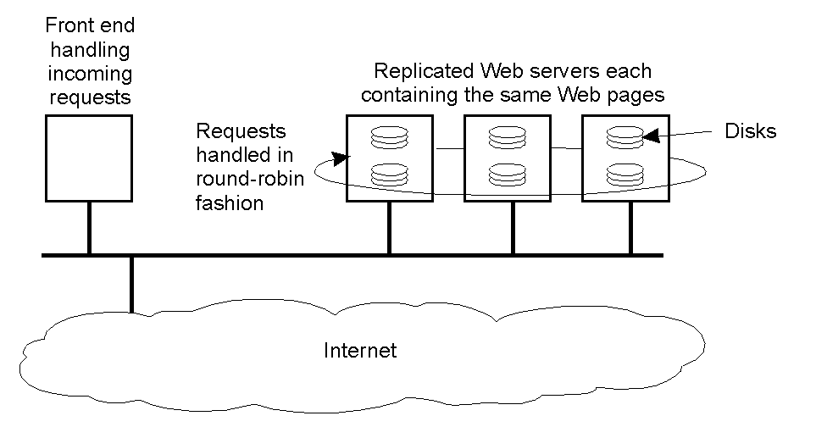
Modern Architectures
1-31
An example of horizontal distribution of a Web service.

